Slide 1
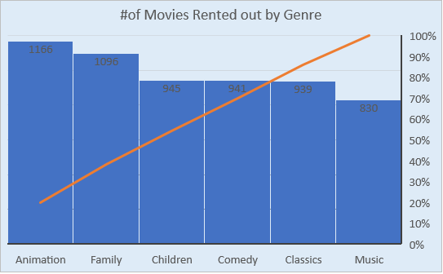
Q1): How many times each genre was rented out?
<In this chart we can see that Animation was rented out the most while Music genre was rented the least>

Slide 2
Q 2) What is the shortest and longest rental duration?
<We can see from this graph that Shortest rental duration is three days while the longest is seven days. Also seen from the graph, same rental days can be categorized into either 1st or 2nd quartile. >

Slide 3
Q 3): Which genre of movie were most checked out in the 4th quartile of rental duration?
< ‘Animation’ and ‘Family’ movies were the most popular genre in the 4th quartile

Slide 4
Q 4) Rentals processed by each store in May and June of 2005?
<Number of rentals are quite close for both stores in May and June of 2005>

